Slide 1
05.12.2022

Slide 2
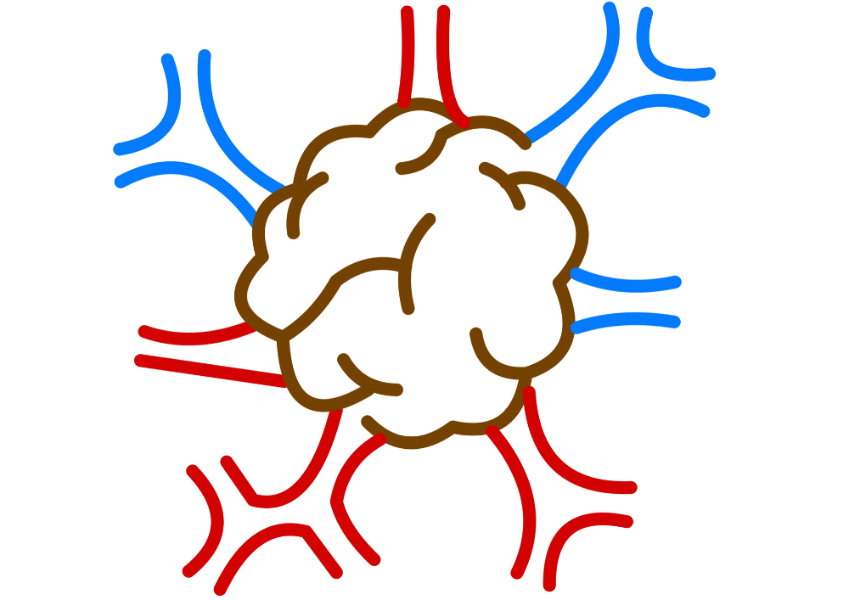
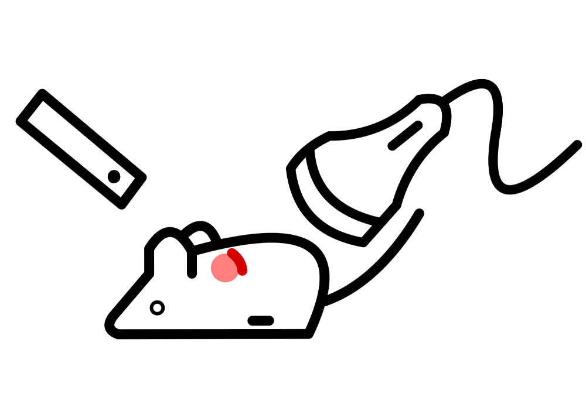
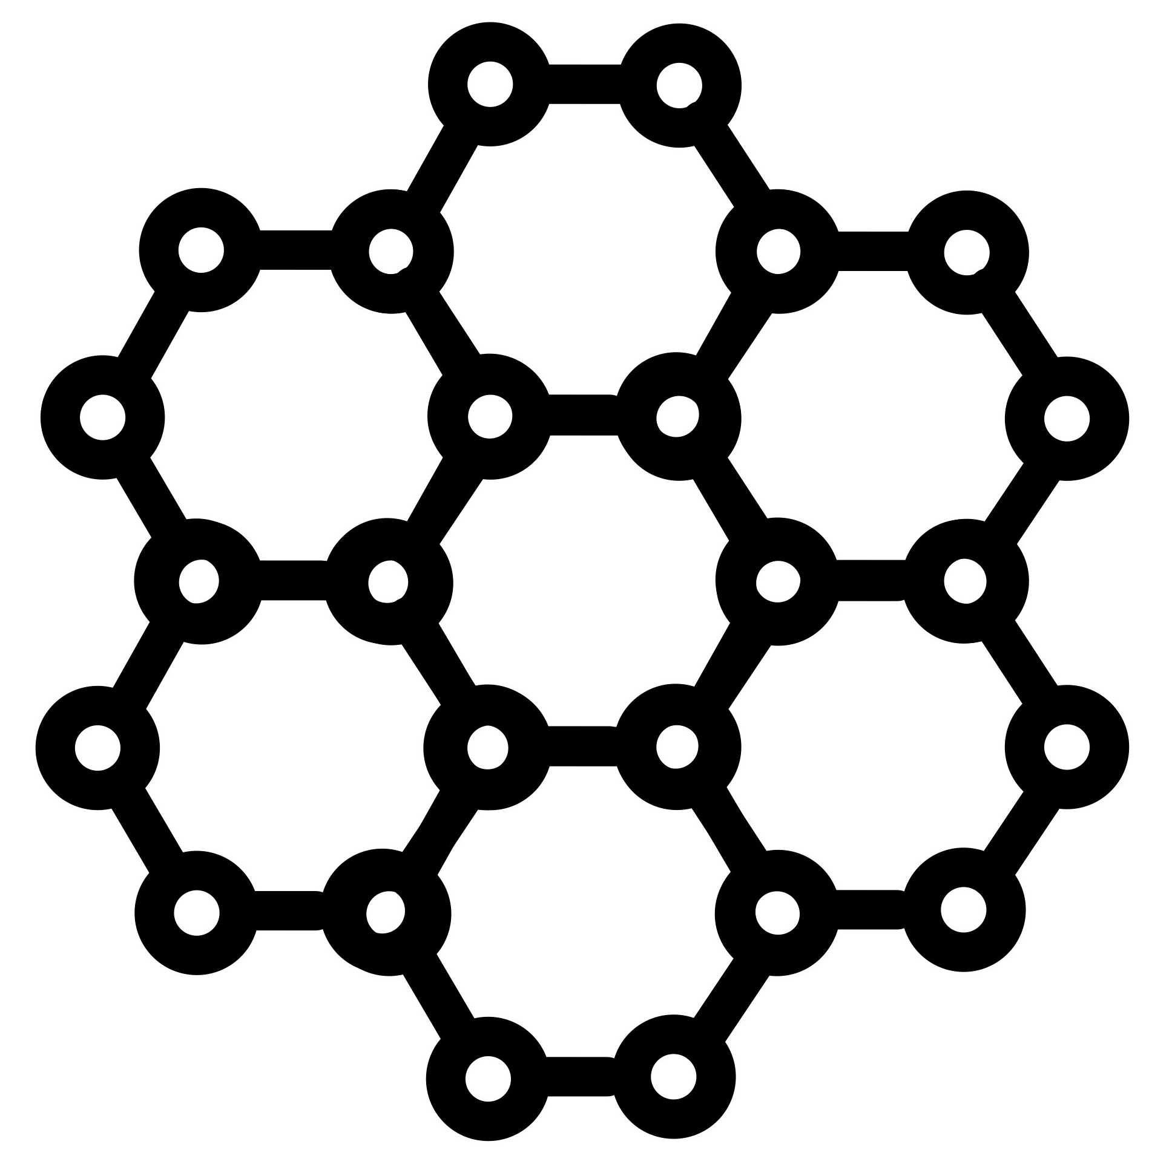
Agenda
Our vision
Optoacoustic imaging
Nanoparticles
Our team
How you can helps us

Slide 3
Our vision
To improve cancer diagnostics
To bring a safe imaging process to the public
To reduce the costs of medical imaging
To make medical diagnostics more accessible
To increase the sustainability of biomedical diagnostics
To beat the MRI scanners

Slide 4
Optoacoustics
The laser is turned on and heats the tissue
The heat induces an expansion which emits acoustic waves
An acoustic detector receives these waves
We reconstruct the images

Slide 5
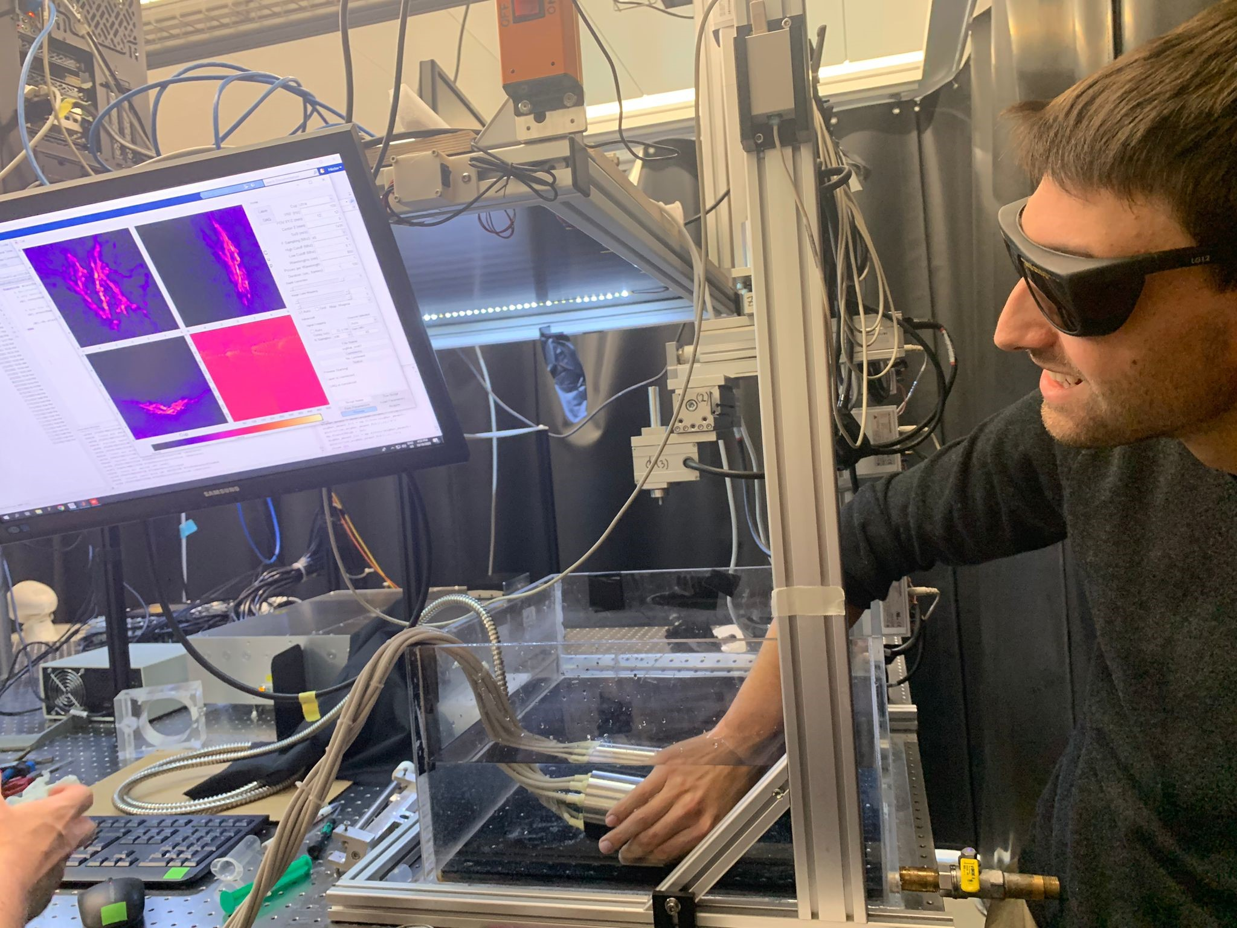
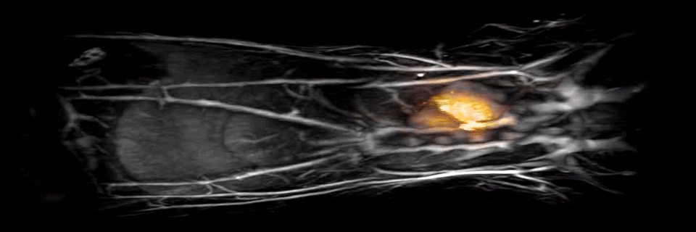
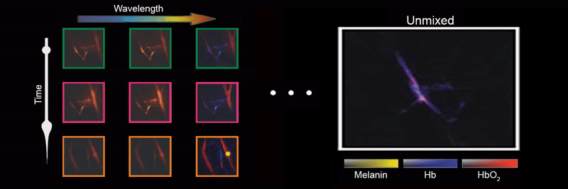
Low Cost
High Precision
Advantages
Fast Imaging
No Toxicity
Great Potential

Slide 6
Nanoparticles
The nanoparticles are injected in the patient.
They flow through the blood stream.
The particles aggregate in the tumor
While imaging, they absorb more heat enabling a better contrast.
Potentially, we could store some medication in the nanoparticles to deliver treatment directly to the tumor.

Slide 7
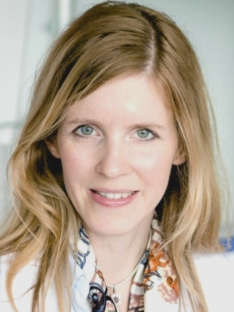
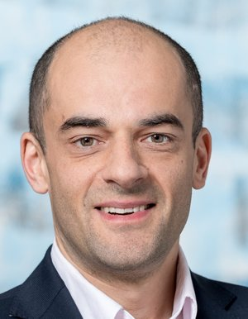
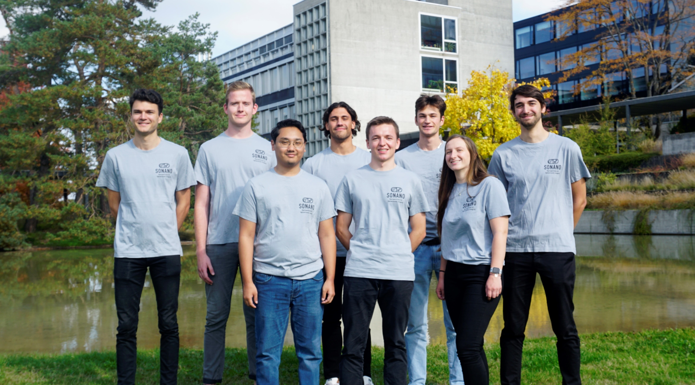
Our Team
8 focus students:
7 mechanical engineers
1 electrical engineer
2 professors
Prof. Inge Herrmann
Prof. Daniel Razansky
4 freelancers

Slide 8
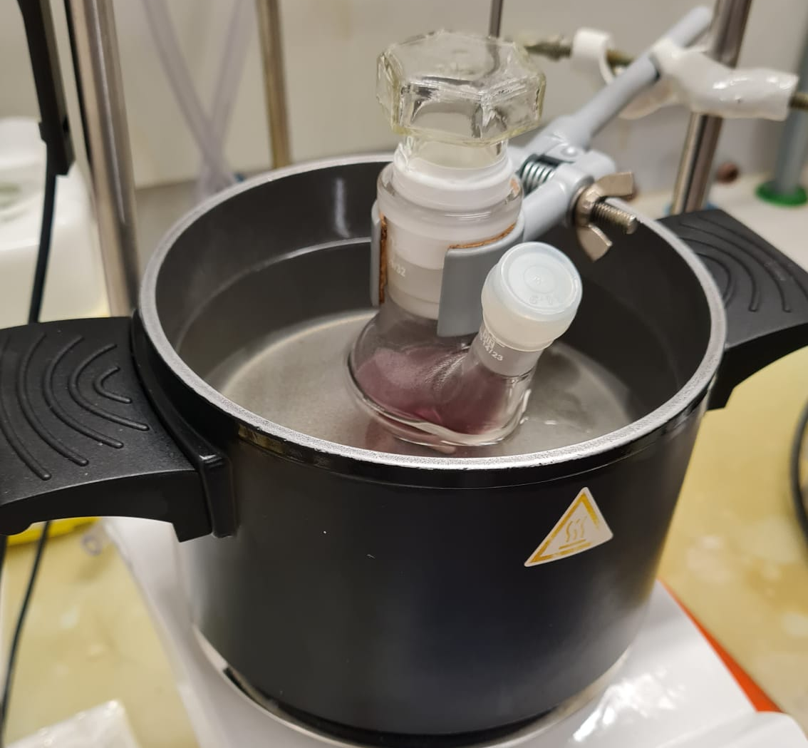
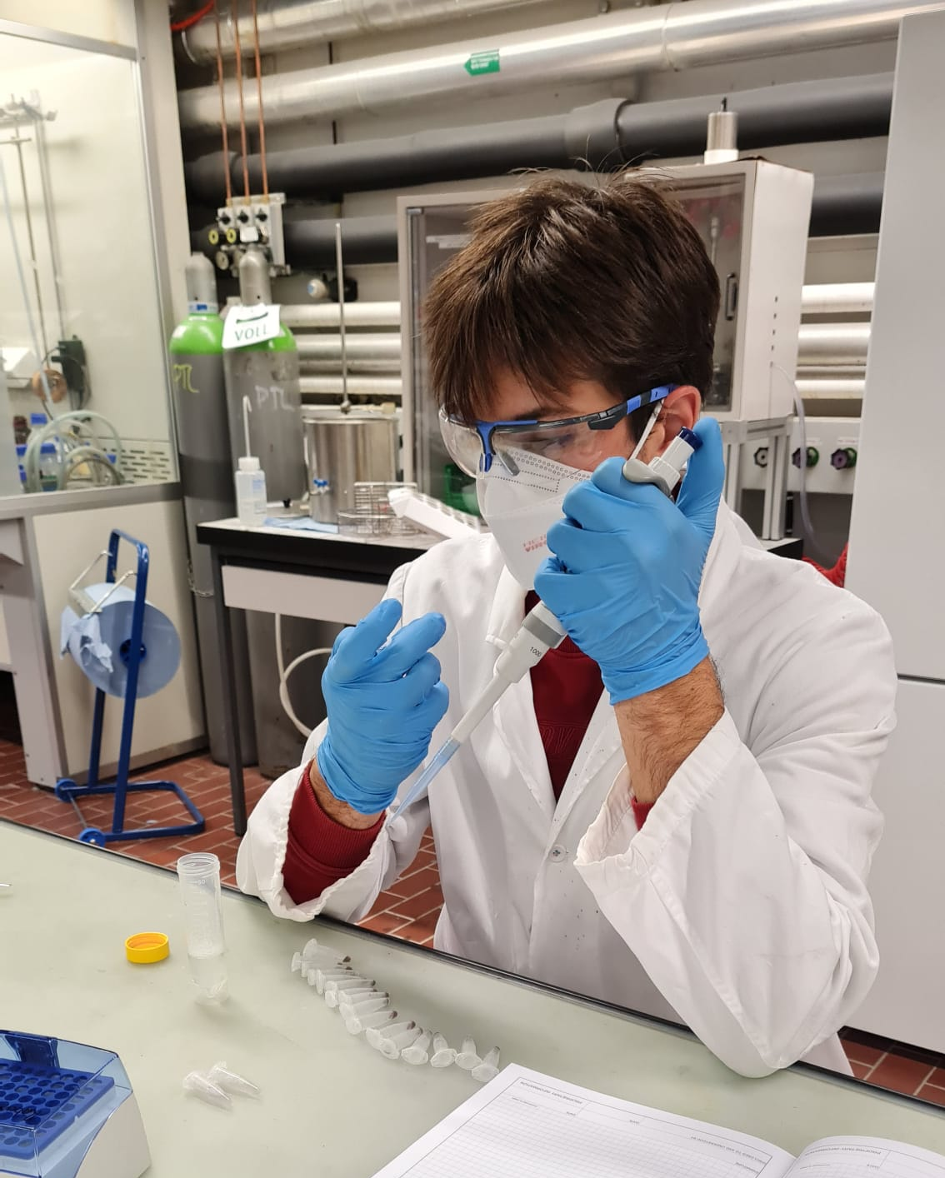
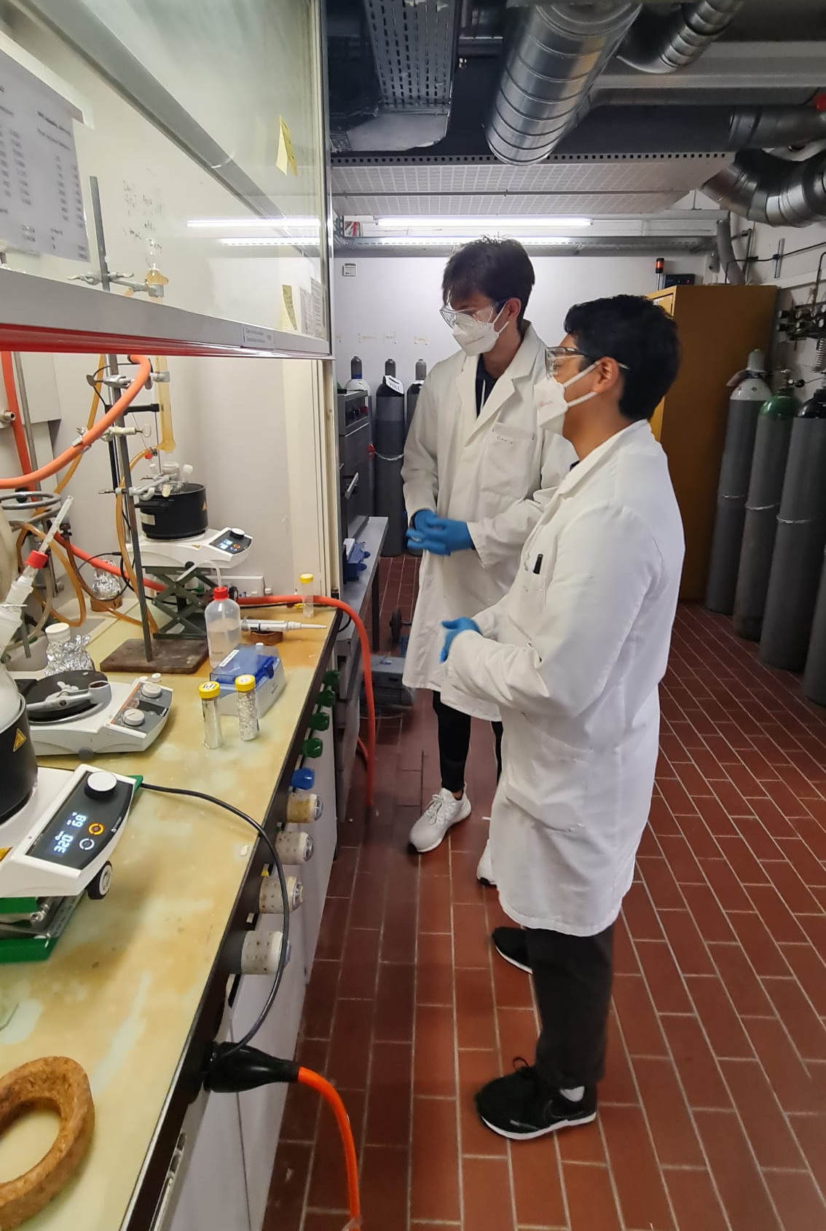
Synthesis Team
Responsible for the development of activatable nanoparticles

Slide 9
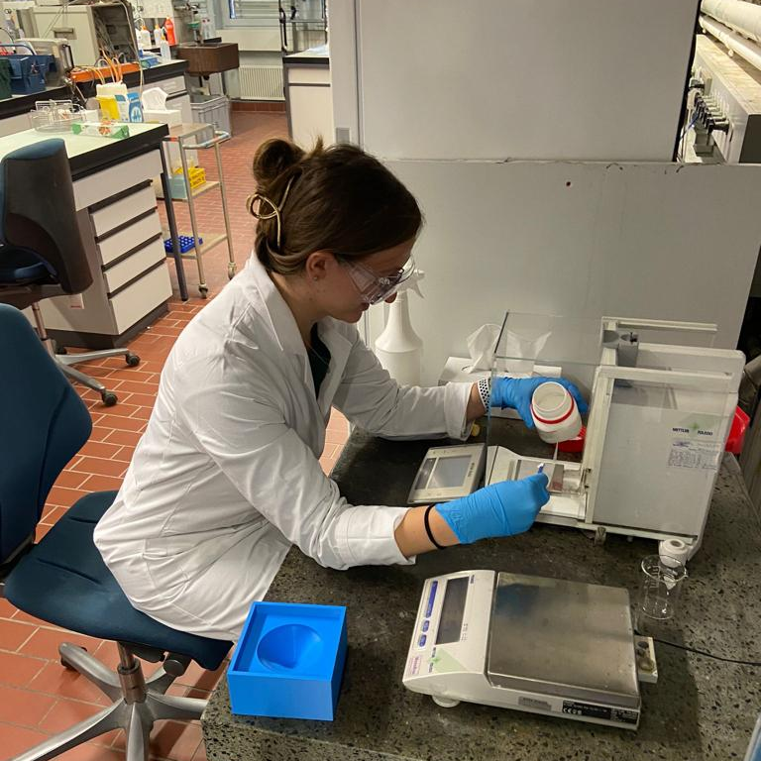
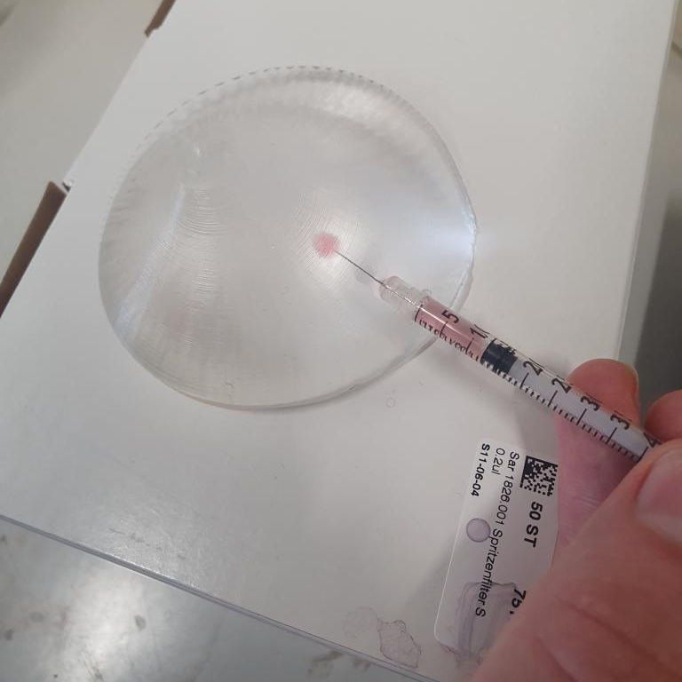
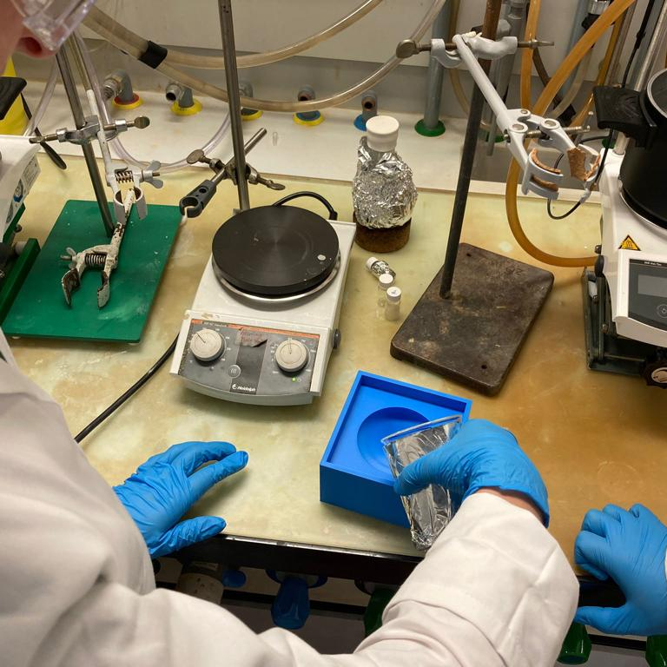
Phantom Team
Responsible for the development of a human-like model

Slide 10
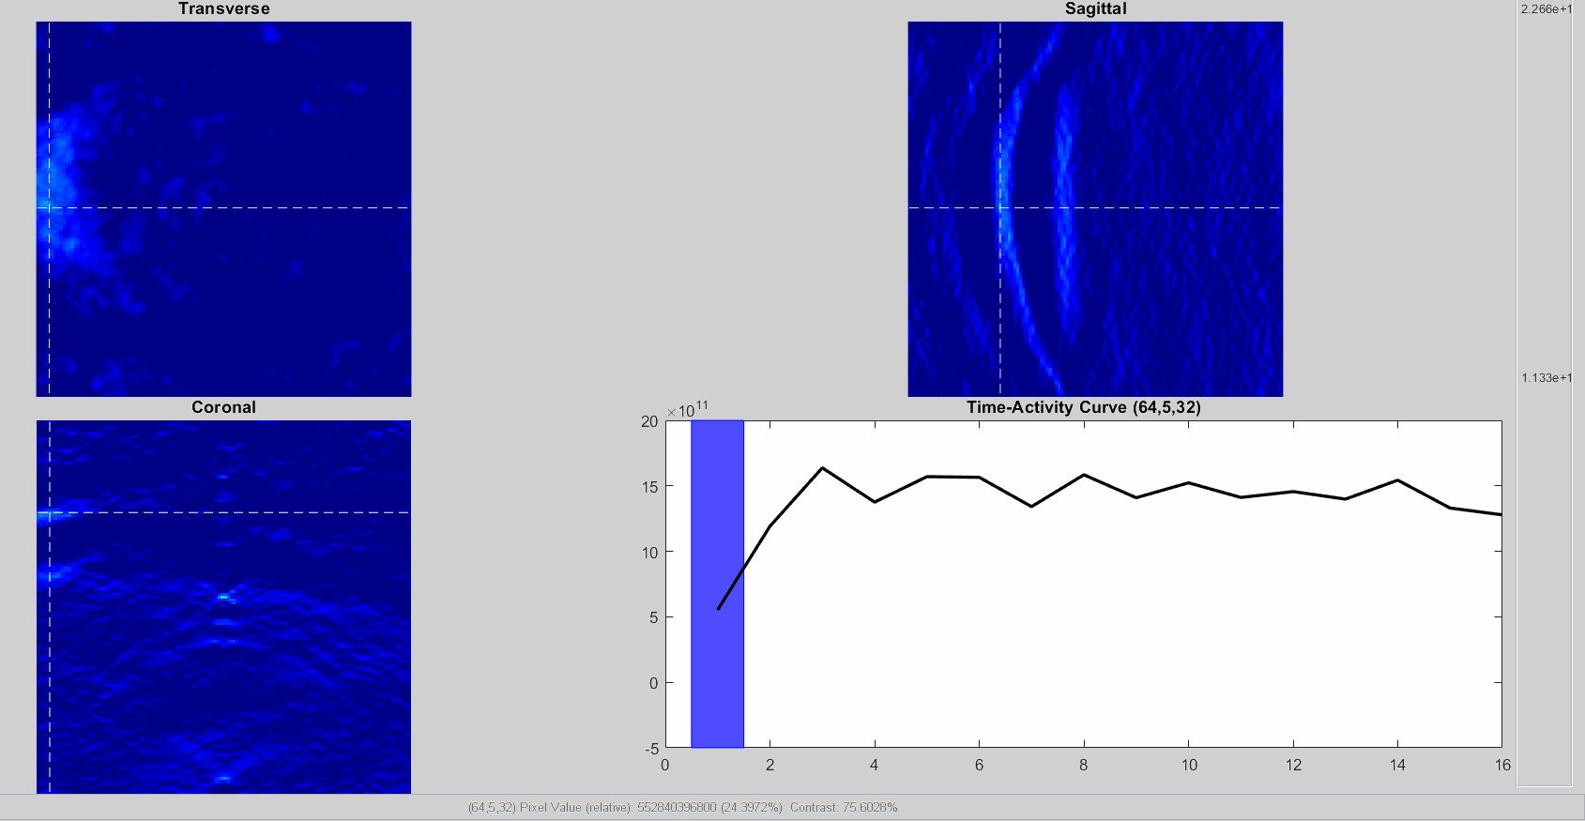
Testing Team
Responsible for handling the tests on the optoacoustic setup

Slide 11
Why do we need your help?
Financial, resources or know-how help:
Explosion protected oven
Chemicals
Oil Bath
Degassing chamber
New Optoacoustic cup
Etc…

Slide 12
Any questions?
You can always contact us:
Mail: sonano@ethz.ch
Website: https://sonano.ethz.ch

Slide 13
Thank you for your attention!

